Slide 1
Databases
Lecture 5

Slide 2
Stages of the design
Conceptual
ER-schema
Logical
«Relational» schema
Physical
Database schema

Slide 3
Design stages: characteristics
Conceptual:
Identification of the most general properties of the subject area - entities and relationships between them
Logical:
Improvement of the conceptual scheme
Formation of relationships and attributes, primary keys, establishment of functional dependencies
Physical:
Improvement of logical schema
Formation of a database schema in relation to a specific DBMS
Defining data types, restrictions, creating technical tables (many-to-many, one-to-one, etc.)

Slide 4
ER-schema: one schema in two notations
FYI - There are two ER diagram (ER diagram) notations:
Peter Chen's notation:
Rectangles are entities (expressed as nouns)
Rhombuses - relationships (verbs)
Ovals – attributes of entities, properties of relationships (adjectives and adverbs)
Crow's foot notation:
Rectangles - entities
The various arcs between them are relationships. Graphically, the arc expresses the cardinality of the relationship

Slide 5
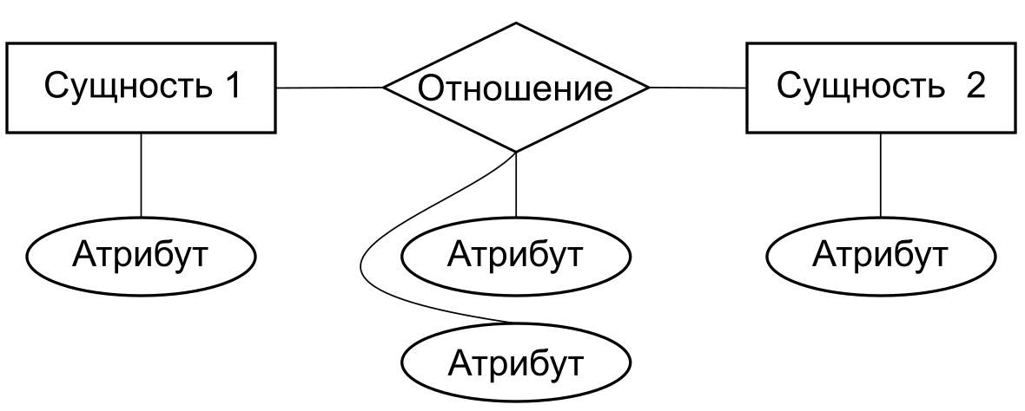
ER-diagram in P.Chen’s notation
Entity 1
Relation
Entity 2
Attribute
Attribute
Attribute
Attribute

Slide 6
ER-diagram in P.Chen’s notation
Singer
to sing
Song
Young
loudly
new
clearly

Slide 7







Notation “crow's foot”
Zero or one
Zero
One and only one
Many
Zero or many
One
One or many

Slide 8
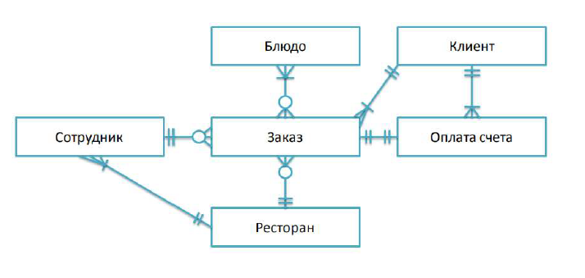
Conceptual model of the restaurant

Slide 9
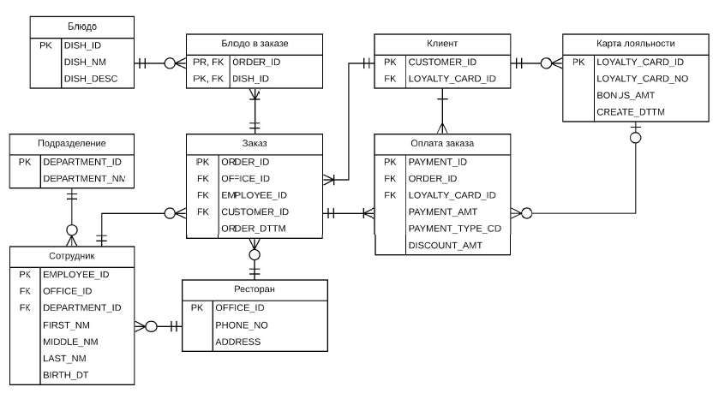
Logical design: relational schema (logical model of the restaurant)

Slide 10
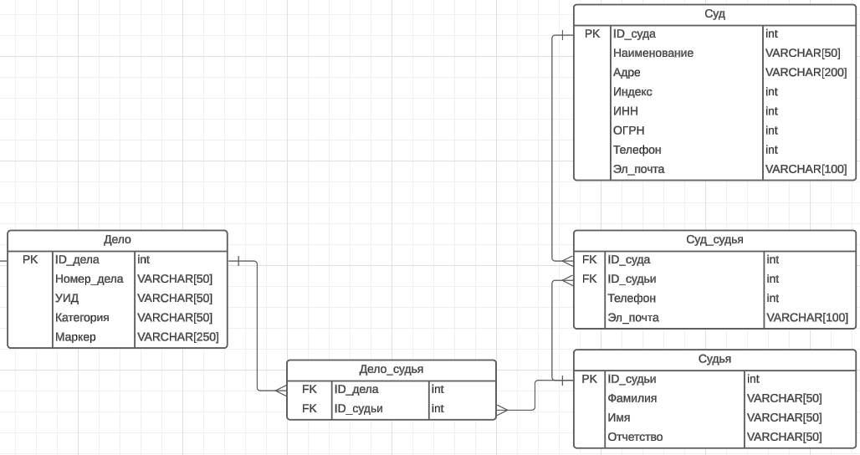
Physical design: task tracker

Slide 11
Для чего необходимо проектировать БД?
Проектирование, помимо очевидных целей определения хранимых данных, также позволяет достичь следующего:
Исключить избыточность данных
Обеспечить поддержку целостности, и, в частности, ссылочной целостности данных.
Это важно для поддержания корректности данных при их хранении и обработки
Если пренебречь качественным проектированием БД, то впоследствии можно столкнуться с различного рода аномалиями :
добавления,
модификации (редактирования),
удаления данных
Для качественного проектирования БД необходимо:
Проводить нормализацию данных
Использовать средства поддержания (ссылочной) целостности (первичные и внешние ключи, ограничения, проверки)

Slide 12
Необходимые в дальнейшем понятия
Целостность (сущностей) – любое отношение должно обладать потенциальным ключом. Поддержание целостности сущностей средствами СУБД: (1) при добавлении записей в таблицу проверяется уникальность их первичных ключей; (2) не допускается изменение значений атрибутов, входящих в первичный ключ
Ссылочная целостность – это необходимое качество реляционной базы данных, заключающееся в отсутствии в любом её отношении внешних ключей, ссылающихся на несуществующие кортежи (по Дж Дейту: база данных не должна содержать каких-либо несогласованных значений внешнего ключа). База данных обладает свойством ссылочной целостности, когда для любой пары связанных внешним ключом отношений в ней условие ссылочной целостности выполняется
Избыточность данных – дублирование данных в базе
Аномалия – ситуация в таблице БД, которая приводит к противоречию в БД либо существенно усложняет обработку БД. Причиной аномалии является (излишнее) дублирование данных в таблице

Slide 13
Goals of design
Goals of design
Avoid redundancy
Provide integrity support

Slide 14
Consequences of low-quality design
Anomalies
Addition anomalies
Editing anomalies
Deleting anomalies

Slide 15
Ensuring the data consistency during the design
Maintaining Data Correctness
Normalization
Means of maintaining referential integrity
Keys

Slide 16
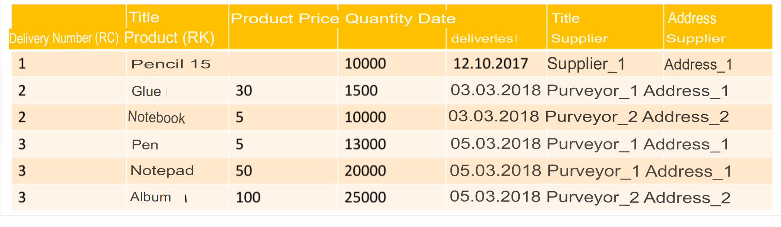
ANOMALIES OF ADDITION
We cannot add a new entry if the values of the primary keys are unknown
We have signed a contract with supplier 3:
We cannot add information about him to the table, because there have been no deliveries yet

Slide 17
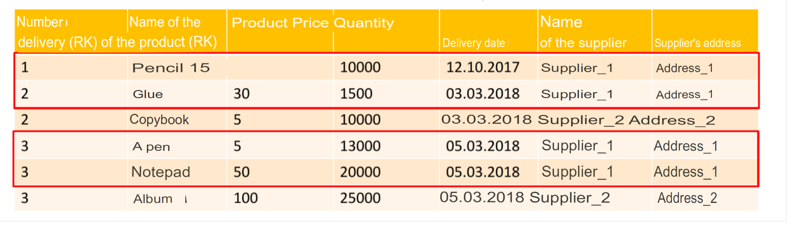
MODIFICATION ANOMALIES
Changing the data of one record entails the need to change the similar data of some more records
Example: to change the distributor 1’s address, we have to change all the rows

Slide 18
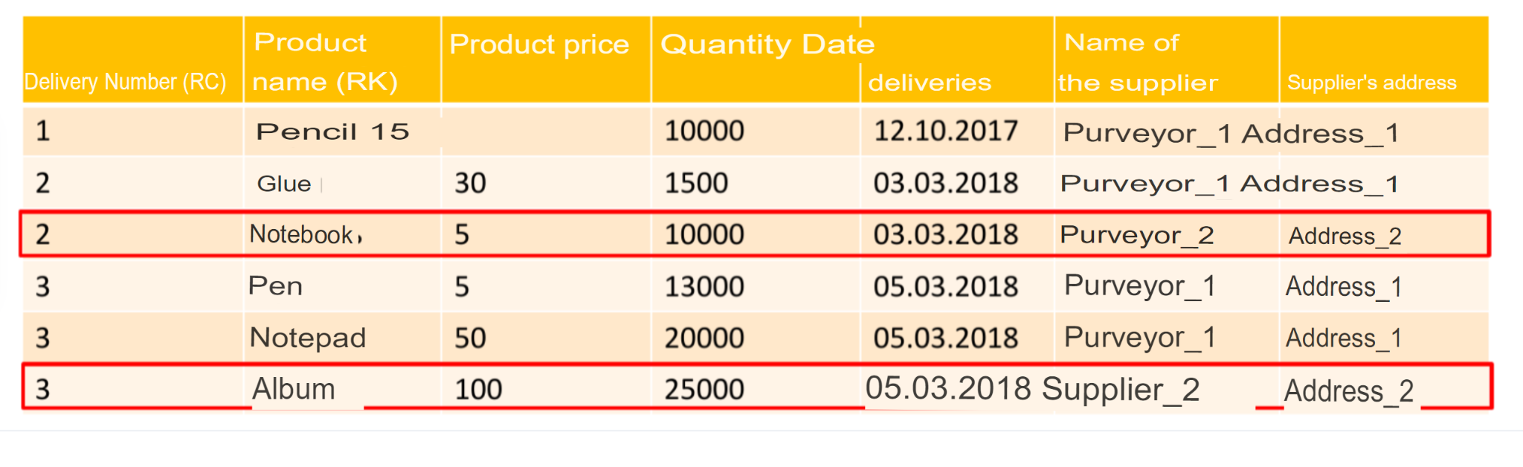
ANOMALIES OF DELETION
Deleting certain records carries the loss of information that you did not want to delete
We want to delete records of deliveries from supplier 2:
We lose all information about supplier 2, including its address

Slide 19
Referential integrity tools - overview
Some SQL commands and statements that allow us to maintain (referential) integrity we have already looked at when getting acquainted with DDL - these are the restrictions specified when creating tables with the CREATE TABLE command:
NOT NULL
UNIQUE
PRIMARY KEY / FOREIGN KEY
CHECK
DEFAULT

Slide 20
Referential integrity tools - overview
In addition to the listed restrictions, you can explicitly set a certain behavior of the DBMS when deleting a certain row or changing a certain value in an external table. External table is a table referenced by a foreign key attribute.
If a data change causes a row to change but the target columns are not affected by the change, no action is taken.

Slide 21
Referential integrity tools - overview
In addition to the listed restrictions, you can explicitly set a certain behavior of the DBMS when deleting a certain row or changing a certain value in an external table. External table is a table referenced by a foreign key attribute.
If a data change causes a row to change but the target columns are not affected by the change, no action is taken.

Slide 22
Referential integrity tools - overview
NO ACTION
Throw an error indicating that deleting or changing a record will violate a foreign key constraint
RESTRICT
Throw an error indicating that deleting or changing a record will violate a foreign key constraint
CASCADE
Delete all rows referencing the deleted record, or change the values in the referencing columns to new values in external columns, in accordance with the operation

Slide 23
Referential integrity tools - overview
SET NULL [ ( column_name [, ... ] ) ]
Set all referencing columns or a specified subset of referencing columns to null. A subset of columns can only be specified for ON DELETE actions
SET DEFAULT [ ( column_name [, ... ] ) ]
Set all referencing columns or a specified subset of referencing columns to their default values. A subset of columns can only be specified for ON DELETE actions. (If the default values are non-NULL, the external table must have a row corresponding to the set of these values; otherwise the operation will fail.)

Slide 24
Syntax example
CREATE TABLE orders (
order_id SERIAL PRIMARY KEY,
customer_id INT REFERENCES customers(customer_id) ON DELETE CASCADE,
order_date DATE,
total_amount DECIMAL
);

Slide 25
Referential integrity tools - keys
According to J. Date:
The definition of a candidate key is essentially just shorthand for some constraint on a relation
Potential keys are important from a practical point of view: in particular, in the relational model they provide the basic addressing mechanism at the tuple level.
This means that the only system-guaranteed way to accurately identify a particular tuple is to use a specific candidate key value.

Slide 26
Keys: potential key
A potential key is a subset of relation attributes in a relational data model that satisfies the following requirements:
• uniqueness - there are not and cannot be two tuples of a given relation in which the values of this subset of attributes coincide (are equal)
• irreducibility (minimality) - the potential key does not contain a smaller subset of attributes that satisfies the uniqueness condition. In other words, if any attribute is removed from a potential key, it will lose its uniqueness property
A candidate key always exists, even if it includes all the attributes of the relation (follows from the properties of the relations). There can be several potential keys.

Slide 27
Keys: primary key
Primary key (PRIMARY KEY) is such a potential key of a relationship that is selected as the “primary”
• Any potential key is suitable as a primary key
Alternate key(s) – all other potential keys of the relationship

Slide 28
Keys: foreign key
To reflect the functional dependencies between tuples of different relations, duplication of the primary key of one relation (parent) to another (child) is used. Attributes that are copies of parent relationship keys are called foreign keys.
A foreign key in relation R2 is a non-empty subset FK of the set of attributes of this relation, such that:
1) There is a relation R1 with a potential key PK;
2) Each value of the foreign key FK in the current value of the relation R2 necessarily coincides with the value of the key PK of some tuple in the current value of the relation R1.
The relationships R1 and R2 are not necessarily different.

Slide 29
Keys property -> functional dependency
Keys allow you to form functional dependencies between relationships
A functional dependency is a many-to-one relationship between two sets of attributes of a given relation variable

Slide 30
Keys property -> functional dependency
Definition of functional dependence (according to J. Date):
Let r be a relation, and X and Y be arbitrary subsets of the set of attributes of relation r. Then Y is functionally dependent on X, which is written symbolically as X → Y (read either "X functionally determines Y" or "X is an arrow of Y")
if and only if every value of the set X of the relation r is associated with exactly one value of the set Y of the relation r.

Slide 31
Keys property -> functional dependency
Definition of functional dependence (according to J. Date):
In other words, if two tuples of a relation r coincide in the value X, they also coincide in the value Y (⬄ there are no two different tuples that have the same values in the X attribute and different values in the Y attribute).
The left part of the functional dependence record is called the determinant, the right part is the dependent part.

Slide 32
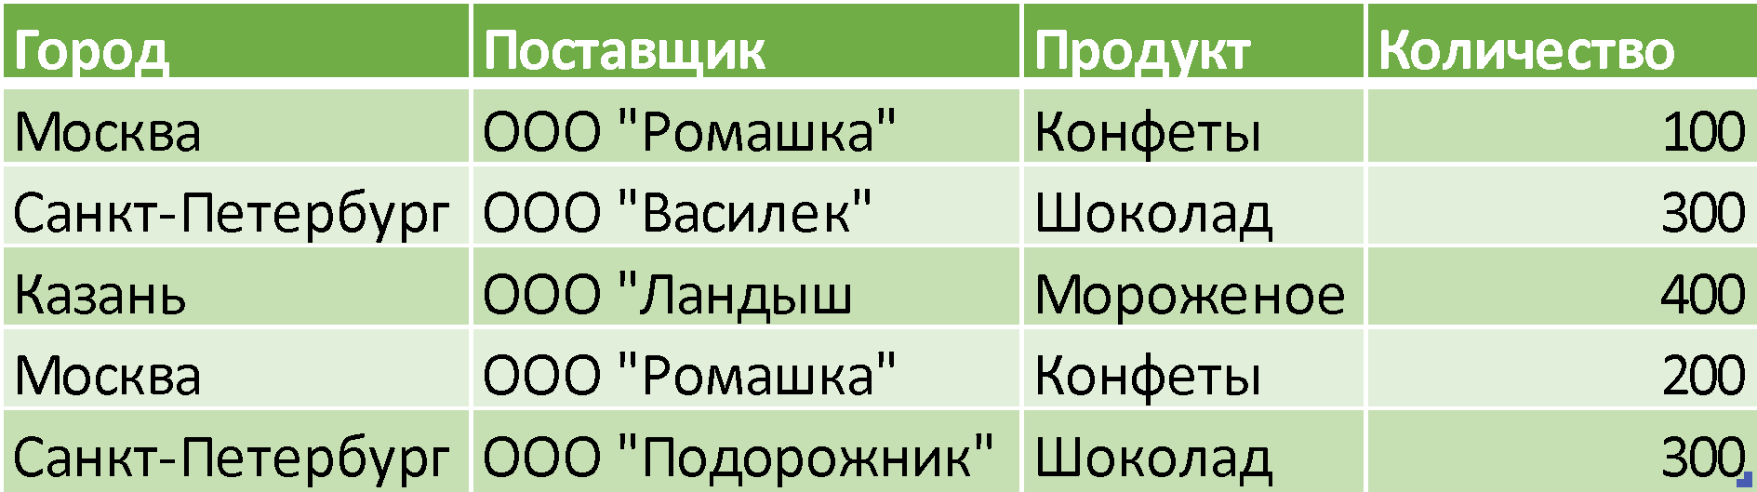
Examples in one table

Slide 33
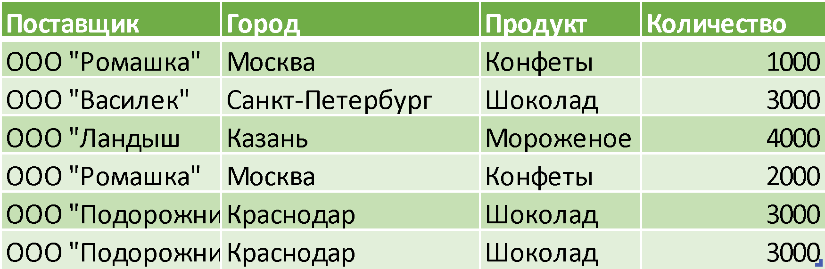
Examples in one table
X -> Y
{City} -> {Product}
{Distributor} -> {City}
{Distributor} -> {Product}
{Amount} -> {Product}
{Amount} -> {City}
{City, Distributor} -> {Product}
{Distributor, Product} -> {City}
Distributor
City
Product
Amount

Slide 34
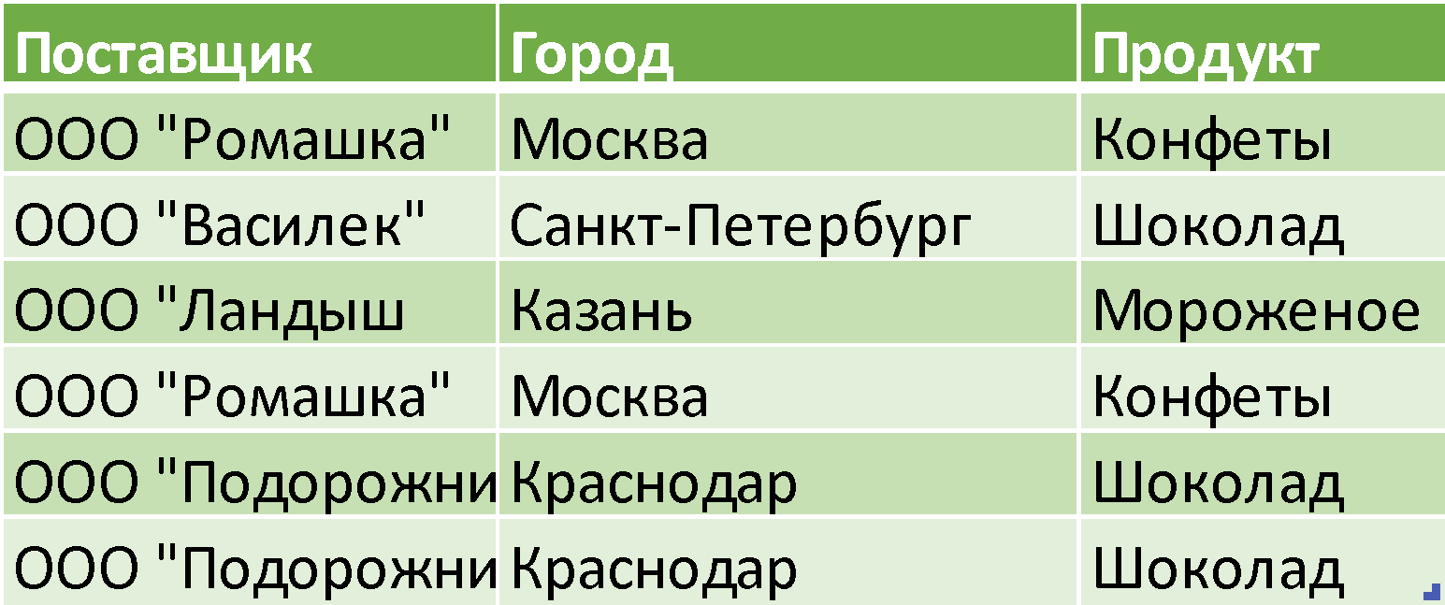
Relation between keys and functional dependencies
Distributor
City
Product

Slide 35
Relation between keys and functional dependencies
X -> Y
{Distributor} -> {City}
{City} -> {Product}
Information is excessive:
we have duplicates
Distributor
City
Product

Slide 36
Relation between keys and functional dependencies
How can we get rid of dupes?
Answer: Heath’s theorem
Distributor
City
Product

Slide 37
Relation between keys and functional dependencies
Heath’s theorem.
Let’s consider a relation R(A,B,C), where A,B,C are attributes. If R satisfies the functional dependency A -> B, then R is a union of R’s projections on attributes (A,B) and (A,C)

Slide 38
Relation between keys and functional dependencies
Distributor
City
Product
A = {Distributor}
B = {City}
C = {Product}
-> {Distributor, City} , {Distributor, Product}}

Slide 39
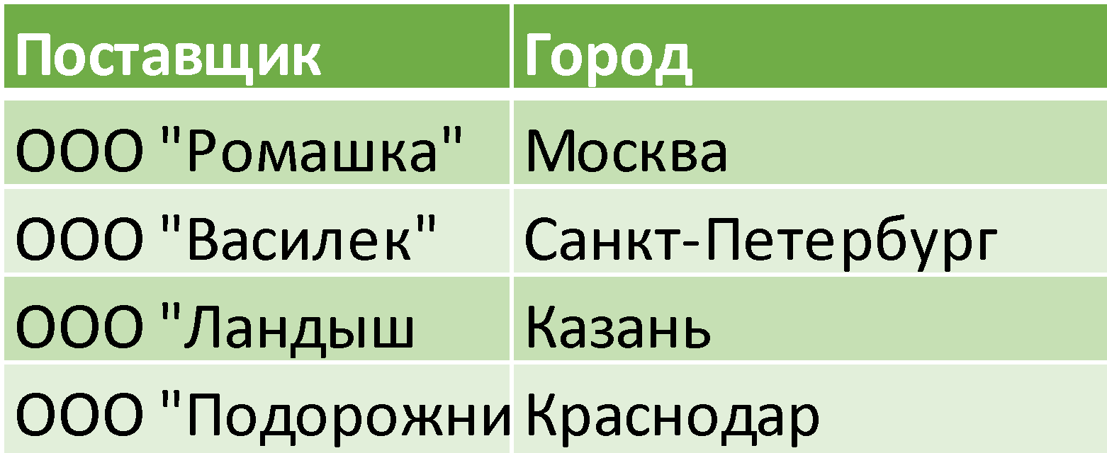
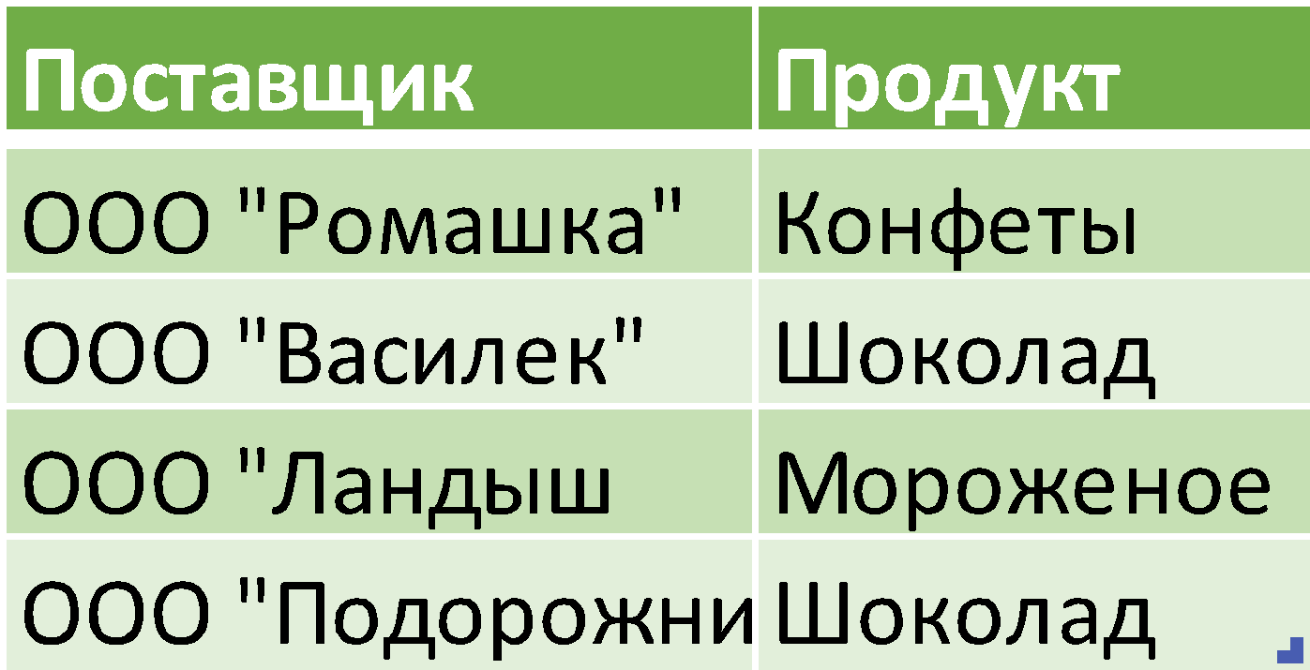
Relation between keys and functional dependencies
Distributor
City
Product
Distributor
City
Distributor
Product

Slide 40
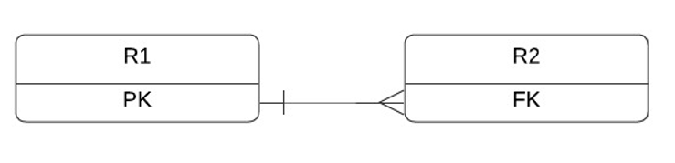
Relation between keys and functional dependencies
In this case, the {Distributor} attribute can be selected as the primary key in the {Distributor, City} relation, and in the {Distributor, Product} relation, this attribute can have a foreign key constraint.
Generalizing the concept of functional dependence, we can (loosely) say that a primary key defines the functional dependence of the table containing it in relation to the table containing the foreign key. That is, if the values of “attributes – foreign keys” are equal, they are always equal to the value of the “attribute – primary key”.

Slide 41
NORMAL FORM
Normal form is a property of a relationship in a relational data model that characterizes it from the point of view of redundancy, potentially leading to logically erroneous results of sampling or data modification
The normal form is defined as a set of requirements that the relation must satisfy
Bringing the database to normal form – normalization
Each following form includes the limitations of the previous ones

Slide 42
DATABASE NORMALIZATION
Exclusion of certain types of redundancy
Elimination of some anomalies* Updates
Development of a database project that is:
High-quality representation of the real world
Intuitive
Easy to expand in the future
Simplification of the procedure for applying the necessary integrity constraints

Slide 43
DATABASE NORMALIZATION
Intended:
Minimizing logical redundancy
Reducing potential inconsistency
Not intended for:
Decrease/increase in DB performance
Decrease / increase in the physical volume of the database

Slide 44
Что такое нормализация и для чего она нужна
Нормализация БД производится за счет декомпозиции отношения (см. выше теорему Хита).
Декомпозиция – разложение исходной переменной отношения на несколько эквивалентных. Декомпозиция обратна соединению
Декомпозиция называется декомпозицией без потерь или правильной , если она обратима

Slide 45
NORMAL FORMS
First Normal Form (1NF)
Second Normal Form (2NF)
Third Normal Form (3NF)
Boyce-Codd Normal Form (BCNF)
Fourth Normal Form (4NF)
Fifth Normal Form / Projection-junction Normal Form (5NF/PJNF)
Domain-key Normal Form (DKNF)
Sixth normal Form (6NF)

Slide 46
1NF
Переменная отношения находится в первой нормальной форме тогда и только тогда, когда значения всех атрибутов отношения атомарны. То есть отношение находится в 1 NF , если все его атрибуты являются простыми. Все используемые домены содержат только скалярные значения.
Неформальное определение:
Все строки должны быть различными
Все элементы внутри ячеек должны быть атомарными, т.е. не должны быть списками. Другими словами, элемент является атомарным, если его нельзя разделить на части, которые могут использовать в таблице независимо друг от друга
Любое реляционное отношение находится в 1НФ на основании свойств реляционного отношения.

Slide 47
THE FIRST NORMAL FORM
A relation variable is in the first normal form if and only if the values of all attributes of the relation are atomic.
A relation is in 1NF if all its attributes are simple. All domains used contain only scalar values.

Slide 48
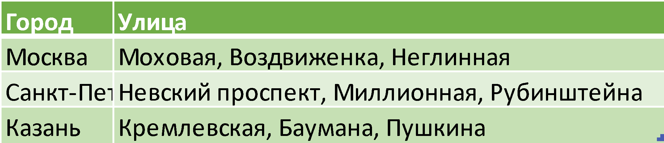
1NF

Slide 49
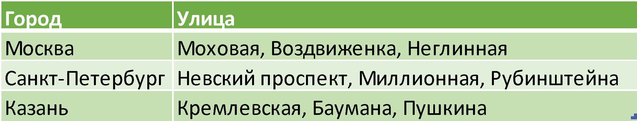
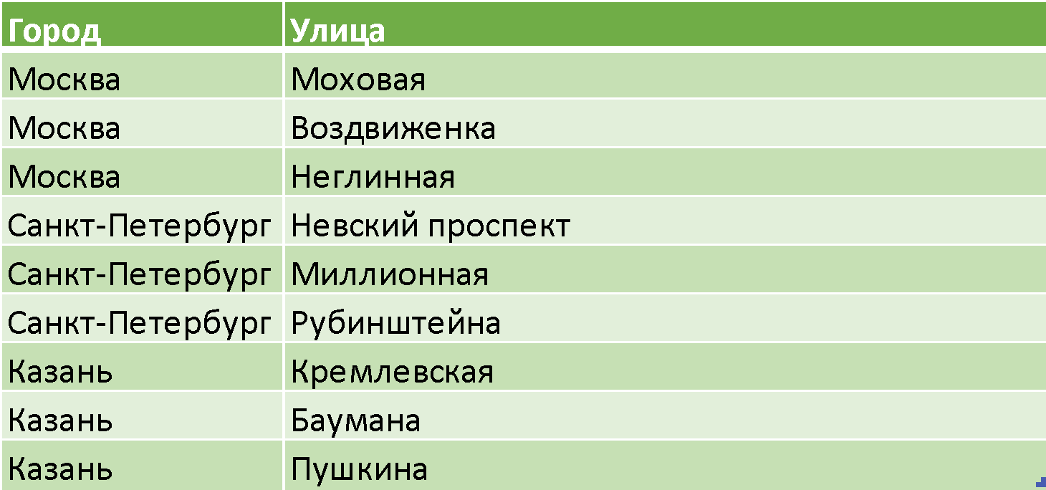
1NF

Slide 50
THE SECOND NORMAL FORM
A relation variable is in the second normal form if and only if it is in the first normal form, and each non-key attribute is minimally functionally dependent on a potential key
The functional relationship between the sets of attributes X and Y means that for any valid set of tuples , the following is true in this respect: if two tuples coincide in the value of X, then they coincide in the value of Y
Minimal functional dependency means that the primary key does not contain a smaller subset of attributes, relations which can also be derived from this functional dependency

Slide 51
2NF
An informal definition for a table with a single key:
The table must be in first normal form
Any of its fields that are not part of the primary key functionally depends only on all the attributes of the key and does not depend on its individual attributes
If a table with a single key is in first normal form and has a unique id for each row, then it is in second normal form.

Slide 52
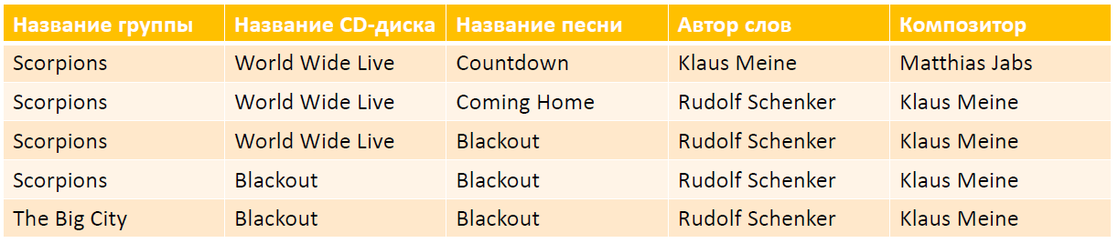
2NF

Slide 53
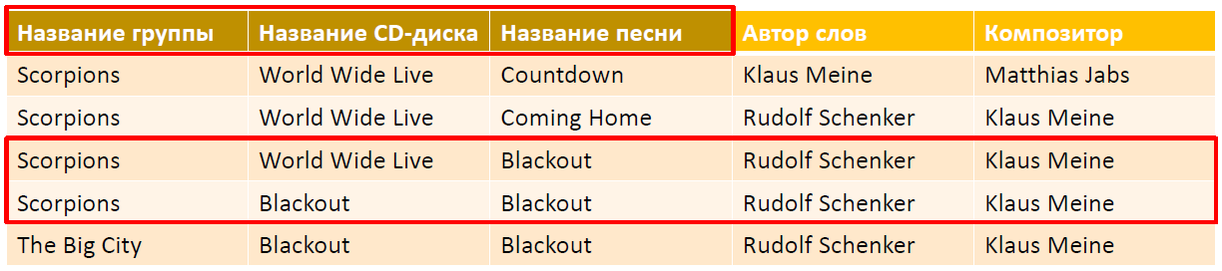
2NF

Slide 54
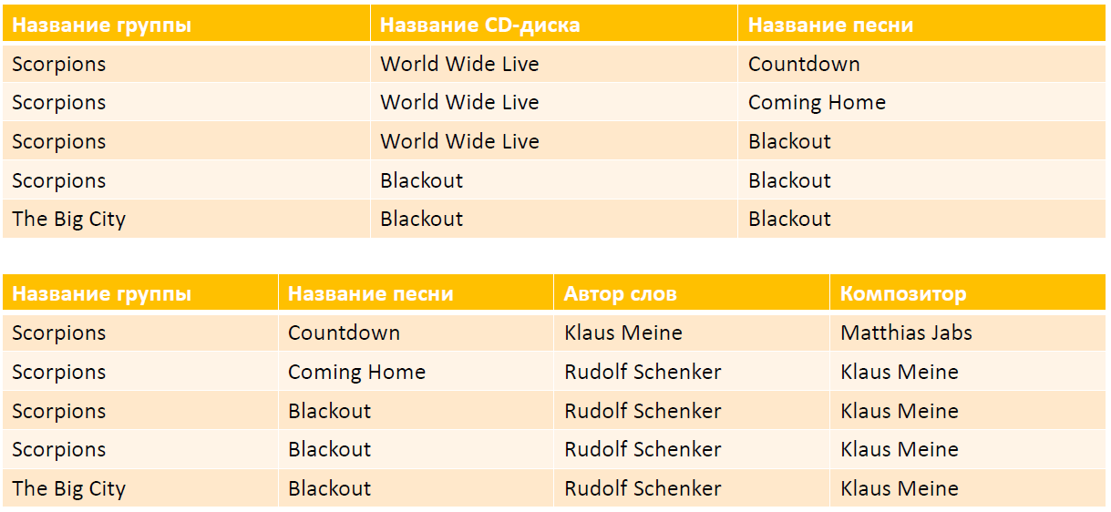
2NF

Slide 55
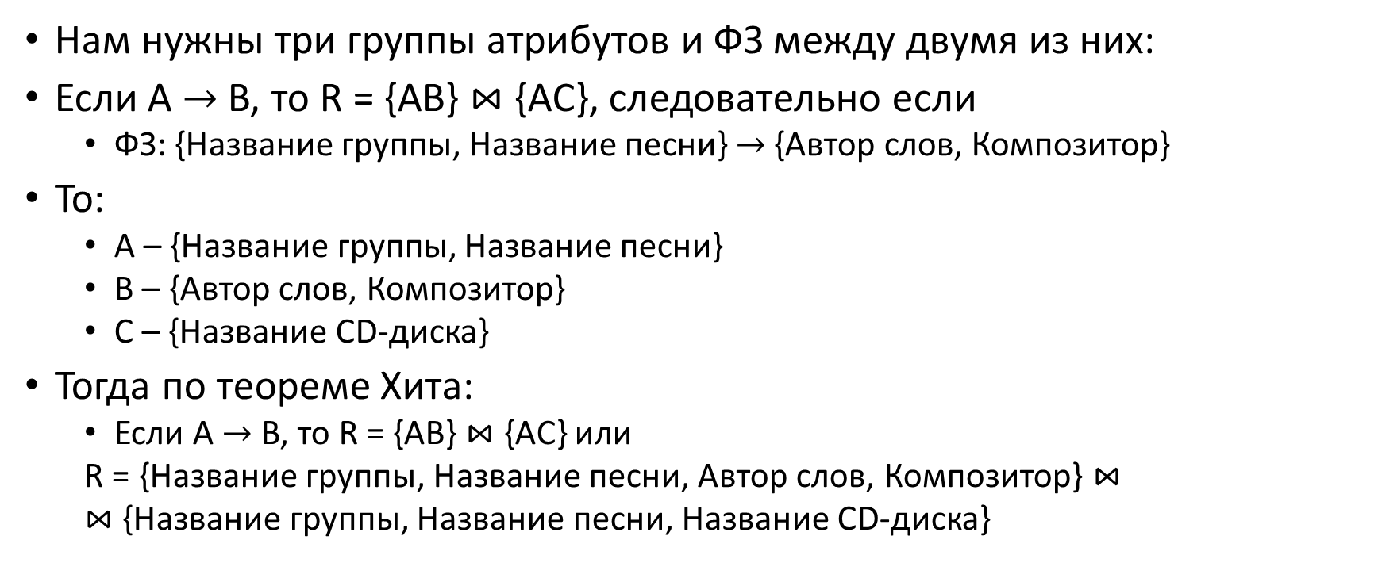
2NF – объяснение применительно к теореме Хита

